Slide 1
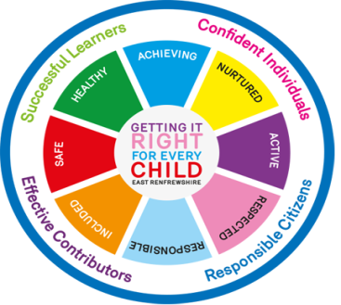
St Peter’s RC Primary School – Our Curriculum Rationale
Vision We care for each other in a community of faith and learning. We strive for excellence and understanding in our learning and behaviour.
Values Trust, Respect, Tolerance, Honesty, Generosity and Forgiveness
Our Key Drivers
Ethos is inclusive and supportive, encouraging a ‘can do’ attitude in pupils and staff.
Sustained focus on excellence in achievement and attainment.
Raise aspirations and broaden outlooks.
Nurture spiritual development.
Respect and tolerance for different ways of learning and living.
Trust among pupils, staff and parents.
Valuing each person’s talents, opinions and contributions.
Planning and assessment are proportionate, useful and collaborative.
Our Learning is
Exciting, stimulating and engaging.
Inter-disciplinary.
Child-centred.
Differentiated to meet the needs of all pupils and challenge them appropriately.
Developing skills, knowledge and positive attitudes.
Purposeful.
Co-operative.
Taking opportunities to learn everywhere – outdoors, online, on short and extended trips.
Coherent and well-planned.
Developing understanding of personal responsibilities for health and wellbeing, the environment and contributing to society.
Totality of the Curriculum
Engagement of all pupils in a class in agreeing key questions for interdisciplinary learning.
Planned and agreed focus for whole school involvement in liturgies, healthy living, EcoSchools and Rights Respecting activities, Global links and enterprises.
Opportunities for all pupils and staff to contribute to assemblies and other events that showcase achievements of all kinds.
Active links with parents, church communities, other schools, libraries, Sport Aberdeen and ASV.
Learning in the school playground and garden, Seaton Park, Cruickshank Gardens, beach and city centre.
Principles for Curriculum Design:
• challenge and enjoyment
• breadth
• progression
• depth
• personalisation and choice
• coherence
• relevance

