Slide 1
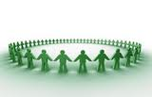
We look after each other.
We are kind.
We are here to learn.

