Slide 1
Extra- Curricular Clubs
Primary 1 - Primary 3
Drawing Club with Miss Lilly and Mrs Carrara
Term 2
Wednesday lunchtimes 1.00pm to 1.30pm
If you are interested, please give your name to our House Captains
when they visit your class!
Please click on the next slide to see more!

Slide 2
Extra- Curricular Clubs
Primary 1 - Primary 3
Outdoor Learning Club with Miss Bentley
Term 2
Tuesday lunchtimes 1.00pm to 1.30pm
If you are interested, please give your name to our House Captains
when they visit your class!
Please click on the next slide to see more!

Slide 3
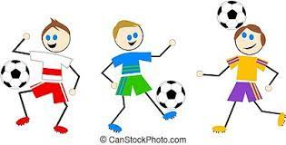
Extra- Curricular Clubs
Primary 1 - Primary 3
RADS After School Club
Term 1 - 4
Mondays 3.15pm to 4pm
*currently full

Slide 4
Extra- Curricular Clubs
Primary 1 - Primary 3
If interested, sign up through Active Schools

